Slide 1

Gokaraju Rangaraju Institute of Engineering and Technology
(Autonomous)
Department of Computer Science and Engineering
GR18A4061 - Major Project
IV Year/ I Semester
Academic year 2021-2022
Title: Face Mask Detection
Members: V Hema Chandana 18241A05O0 M Kiranmayi 18241A05L7 G Ramya 18241A05J8 A Elizabeth 19245A0524
Batch no: D5 Guide: G. Anil Kumar

Slide 2
Contents
Problem Statement
Literature Survey
Existing System
Proposed System
UML diagrams
Proposed Modules
References

Slide 4
Problem Statement
COVID-19 pandemic has rapidly increased health crises globally and is affecting our day-to-day lifestyle.
A motive for survival recommendations is to wear a safe facemask, stay protected against the transmission of coronavirus.
By wearing a facemask, the most effective preventive care must be taken against COVID-19.

Slide 5
Problem Statement
Monitoring manually if the individuals are wearing face mask correctly and to notify the victim in public and crowded areas is a difficult task.
This project approaches a simplified way to achieve facemask detection and notifying the individual if not wearing facemask. The system runs in real-time and detects if an individual face has facemask if not then notifies the person-in-charge that the individual has not been equipped with mask.

Slide 6
Literature Survey
The facemask detection model has become a most required and essential model during COVID-19 pandemic. Manually monitoring whether people are wearing facemask in public and crowded areas is very difficult.
There are different approaches which do not use machine learning to build a facemask detection model. But here we use image processing through openCV to detect faces in images and we use machine learning i.e. Classification to train the model.
2/10

Slide 7
Existing Modules
Facemask detection model has become a most essential model during COVID-19 pandemic. Since manually monitoring is difficult,, many models were developed.
One such approach is built as real-time automated model integrated with surveillance cameras in public for detection and report to respective authorities using raspberry pi4.
Using such IOT models require a hardware support, which can be costly and sensitive. Even if a single wire has been damaged then the entire project will shut down. These are costly, unstable and sometimes inaccurate as well.

Slide 8
Proposed System
Here our system uses Image processing and Machine learning techniques.
First we collect the data of images of faces with and without mask.
For applying Image processing we use Viola-Jones algorithm for detecting the faces.
After that we apply machine learning techniques like Convolution Neural Network(CNN) for training the model with the data.

Slide 9
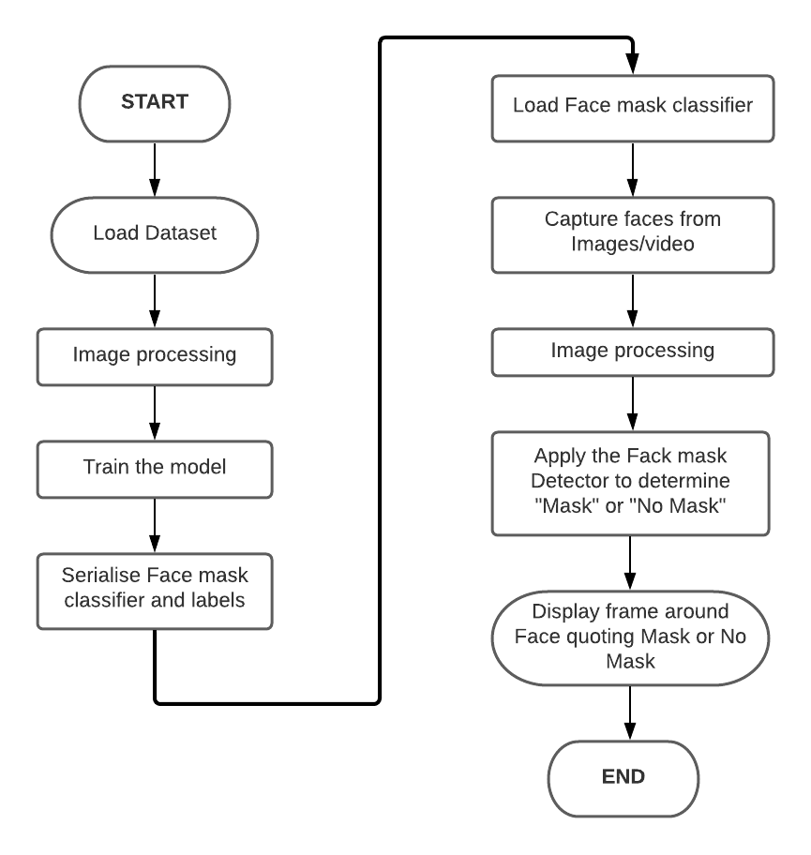
Data Flow Diagram

Slide 10
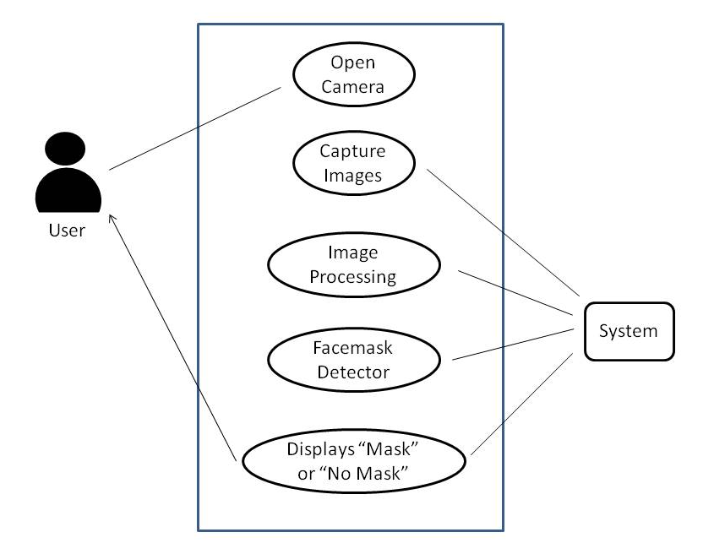
Use Case Diagram

Slide 11
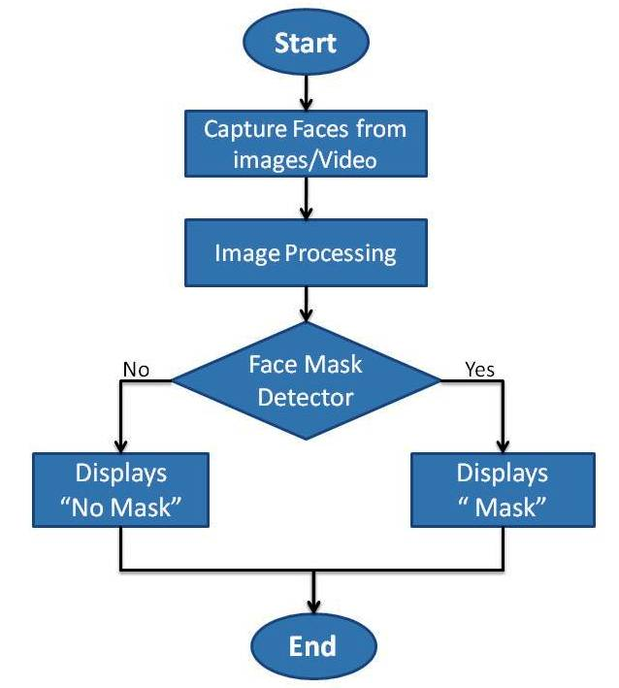
Activity Diagram

Slide 12
Proposed Modules
The project will have these important phases:
Module 1: Collection of Data:
The proposed system uses data containing images with different angles and different poses of face with and without masks.
Module 2: Faces Detection - Image processing:
The main function of Image processing in our project is to detect faces with or without mask. This process is done during the training phase as well as during real-time detection.

Slide 13
Proposed Modules
Module 3: Training the Model with Data:
In the proposed system the custom dataset will be loaded and will be trained based on labelled images. Here we’re using Supervised Machine learning for training the model. Under Supervised Learning, there are different sub categories like - Regression, Classification, Clustering etc. Here we are using Classification with the data collected with and without masks, which is properly preprocessed.

Slide 14
Proposed Modules
Module 4: Real-Time Detection:
Our system works in a automated manner. When an image frame is captured, image processing is performed to detect faces in it. Then those faces are classified as with or without masks using Machine Learning. We get the result in the same frame with a square box around the faces and label saying with a mask or without mask.
Module 5: Implementing the Model:
Our system uses a custom dataset with the input video taken from any camera device. The system feeds with a real time video in public places which automatically monitors and detects whether people are wearing face masks or not.

Slide 16
References
[1]. Suresh K, Palangappa MB, Bhuvan S : “ Face Mask Detection by using Optimistic Convolutional Neural Network “ at International Conference on Inventive Computation Technologies [ICICT 2021]
[2]. Yadav S. “Deep learning based safe social distancing and facemask detection in public areas for COVID-19 safety guidelines adherence.” Int J Res Appl Sci Eng Technol. 2020;8(7):1368-1375.

Slide 17
References
[3]S, Akshay & Bhat, Mandara & Rao, Aishwarya. (2019). “Facial Expression Recognition using Compressed Images.” International Journal of Recent Technology and Engineering. DOI:10.35940/ijrte.B1041.078219.
[4]Loey M, Manogaran G, Taha MHN, Khalifa NEM. “A hybrid deep transfer learning model with machine learning methods for face mask detection in the era of the COVID-19 pandemic.” Measurement (Lond). 2021;167:108288.

